Slide 1


Full-Text Search Using hibernate search
Ajay Jagannath (1636203)

Slide 2
OVERVIEW
Hibernate Search is a full text search engine.
In a full-text search, a search engine examines all of the words in every stored document as it tries to match search criteria specified by the user.
Apache Lucene is a powerful full text search engine by itself. However Lucene suffers several mismatches when dealing with database entities.
Using Hibernate ORM to persist with database entities and using Elastic Search/Apache Lucene for Indexing + Searching constitutes Hibernate Search which creates a comprehensive search engine devoid of mismatching issues.

Slide 3
Technology Stack
jdk-11.0.11
Maven 3.6.3
Quarkus 1.13.7
IntelliJ IDEA Community Edition 2021.1.2
Elasticsearch-7.13.2-windows-x86_64
Postman 8.6.2
pgAdmin 4 v5

Slide 4
Setting UP
Elastic Search
Run Elastic Search at localhost:9200
PostgreSQL
Create an database as specified in the project
JAVA Project
Execute the project files from the IDE or using JAR file.
Postman
User/Client side access using Postman or localhost:8080

Slide 5

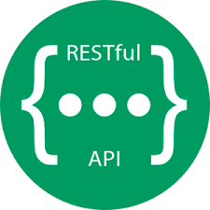
Process Flowchart
PUT, POST & DELETE Requests
Persisting Data
Execute Query
GET Request
Analysis
PostgreSQLDatabase
Hibernate Search Query
Elastic Search
Index
Indexing
Get Results
Fetch
User
Pre-existing Data from database gets Indexed.
User sends a Rest API request to Hibernate search Query.
If it is a Get request, Full text Search occurs to match the query with instances of the entity. The Fetched result is returned.
Otherwise Hibernate ORM is used to persist data in the database. Indexing of the new data is done automatically

Slide 6
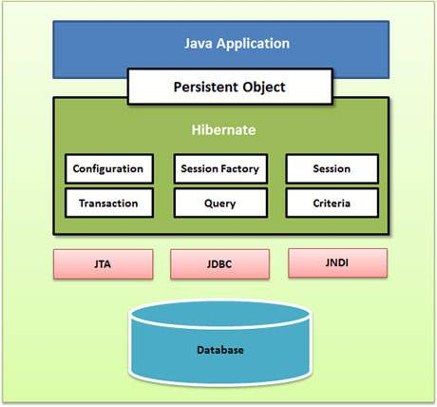
Hibernate ORM
ORM stands for Object-Relational Mapping (ORM) is a programming technique for converting data between relational databases and object oriented programming languages allowing for their interaction without mismatches.
Hibernate sits between traditional Java objects and database server to handle all the works in persisting those objects based on the appropriate O/R mechanisms and patterns.
Configuration Object
Session Object
The Configuration object is the first Hibernate object you create in any Hibernate application. It is usually created only once during application initialization. It represents a configuration or properties file required by the Hibernate.
A Session is used to get a physical connection with a database. The Session object is lightweight and designed to be instantiated each time an interaction is needed with the database. Persistent objects are saved and retrieved through a Session object.
Transaction Object
A Transaction represents a unit of work with the database and most of the RDBMS supports transaction functionality. Transactions in Hibernate are handled by an underlying transaction manager and transaction (from JDBC or JTA).

Slide 7
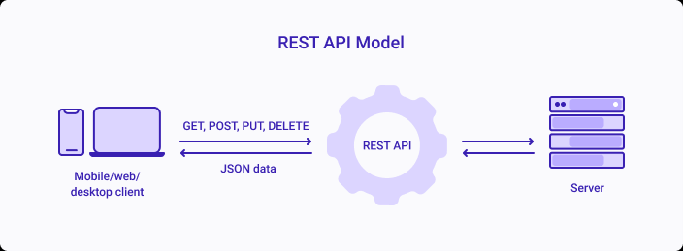
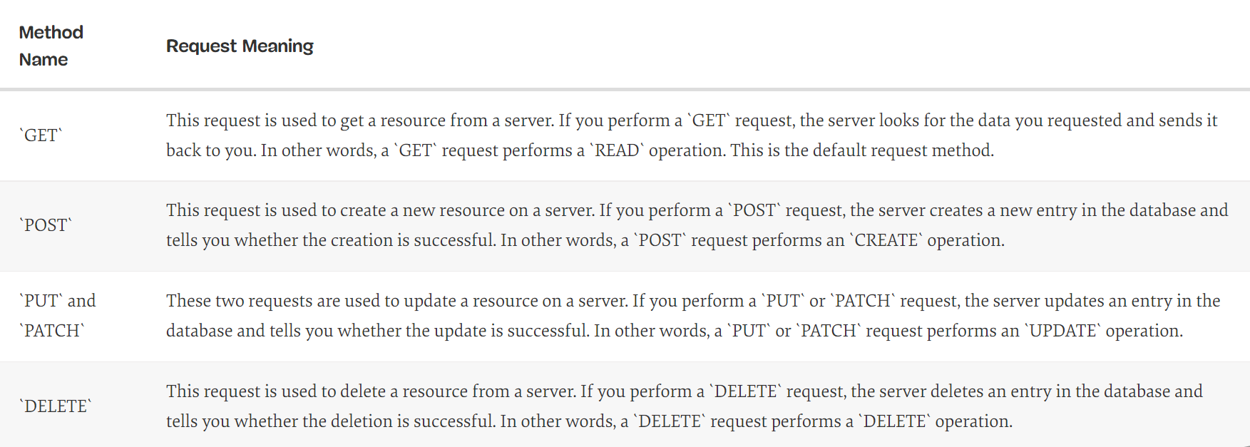
Rest API
REST API is an application programming interface is a set of rules that allows the user to communicate with the server.
It stands for “Representational State Transfer”.
Each URL is called a request while the data sent back to you is called a response.
They are used to perform four possible actions: Create, Read, Update and Delete (CRUD).

Slide 8
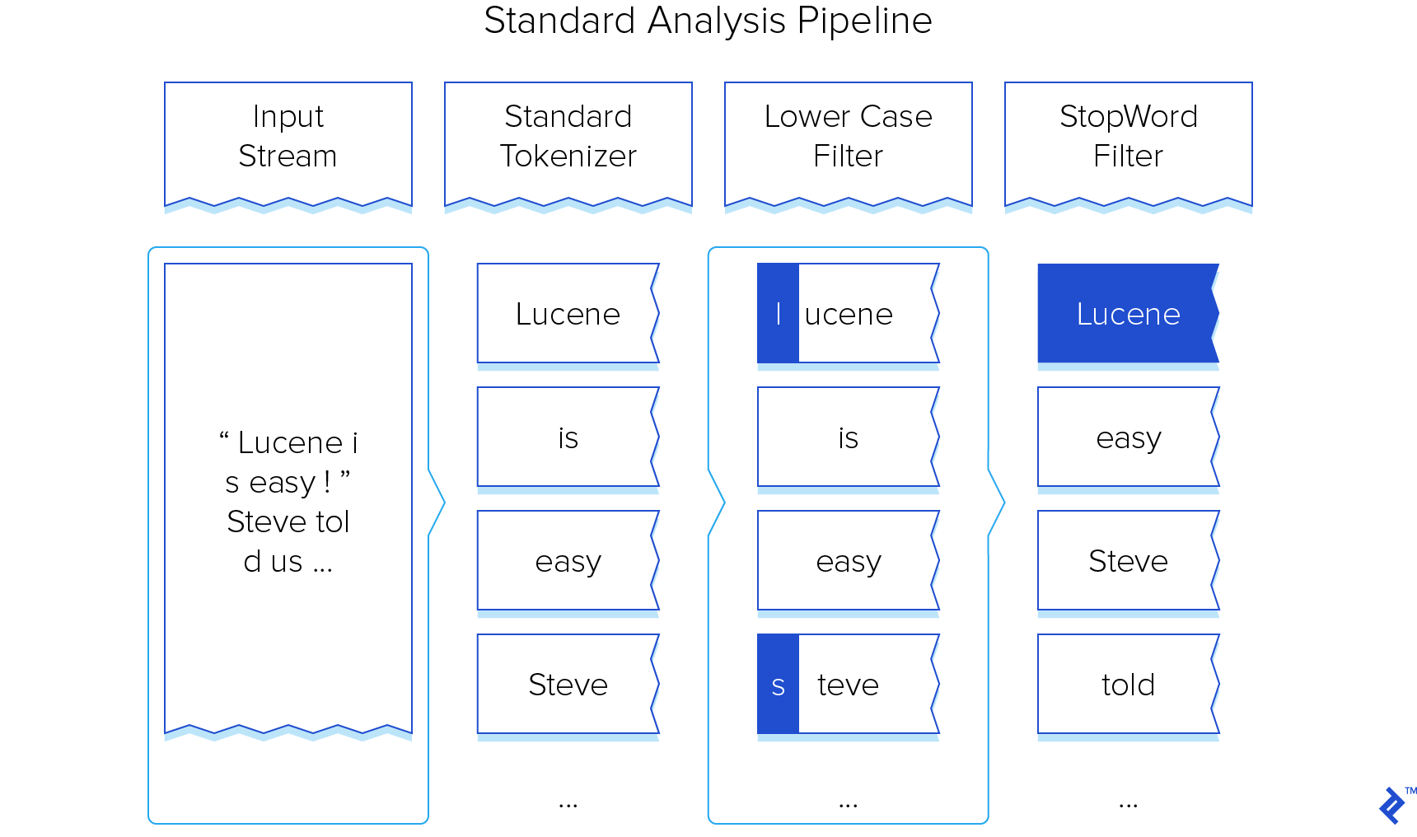
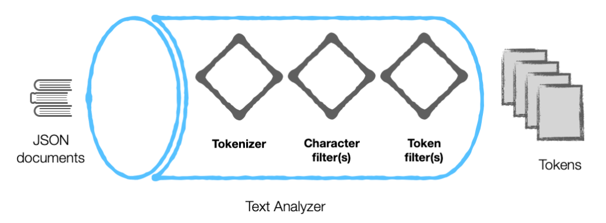
Analysis
Analyzers pre-process input-text submitted for Full Text Search, typically by removing characters that might prohibit certain match-options. Analysis is performed on document-contents when indexes are created and is also performed on the input-text submitted for a search.
Analyzer Architecture
Character Filters
removes undesirable characters from input: for example, the character filter removes HTML tags, and indexes HTML text-content alone.
Tokenizers
split input-strings into individual tokens, which together are made into a token stream. The nature of the decision-making whereby splits are made differs across tokenizers.
Token Filters
performing additional post-processing on each token in the stream provided by the tokenizer. This may include reducing tokens to the stems of the dictionary-based words from which they were derived or removing any remaining punctuation from tokens

Slide 9
Indexing
When the number of documents to search is potentially large, or the quantity of search queries to perform is substantial, the problem of full-text search is often divided into two tasks: indexing and searching.
Indexing is the process by which search engines organize information before a search to enable super-fast responses to queries.
In the search stage, when performing a specific query, only the index is referenced, rather than the text of the original documents.
Inverted Indexing: Elastic search uses inverted index, which counts every term, every word, number, etc. in every document with an indication of which documents contain that term and where they occur in the documents.
Indexing drastically increases Search speeds.
Example

Slide 10
Entities
Author
FirstName
LastName List of Books
Book Title Author
Book Title Author
Book Title Author
M
O
M
M
@OneToMany: Specifies a many-valued association with one-to-many multiplicity.
@ManyToOne: The @ManyToOne annotation may be used within an embeddable class to specify a relationship from the embeddable class to an entity class.
Using the OneToMany and ManyToOne together ensures bidirectional relationship between the embedded class and the entity class.

Slide 11
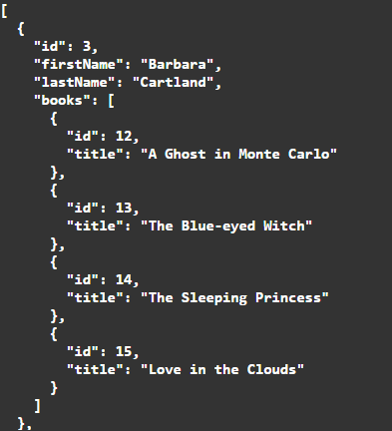
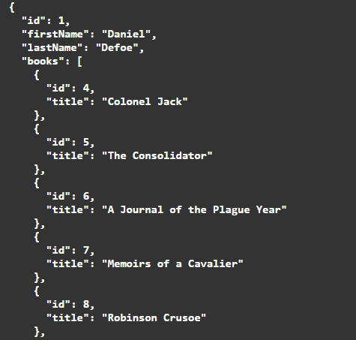
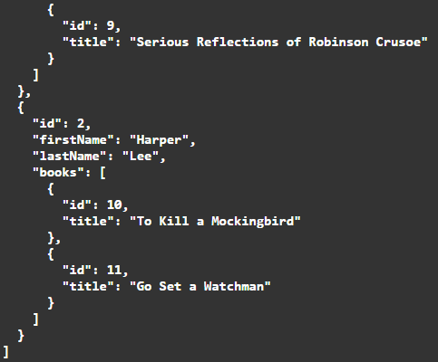
Sample data
All Entities

Slide 12


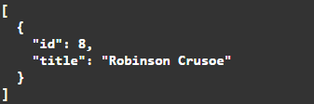

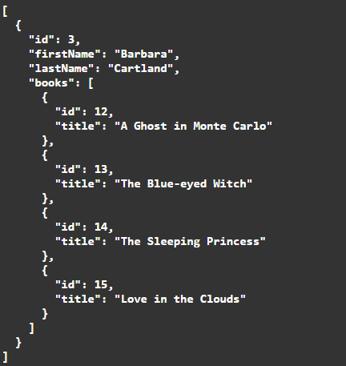
Time taken to get all entities
Get entity by index
Search contains: A (or) in (AND) the
An n-gram is a contiguous sequence of n items from a given sample of text or speech. In edge n-gram only prefix of defined lengths considered.
Min:3 Max:6 Applying This to Author Name. Searching for “card”

Slide 13
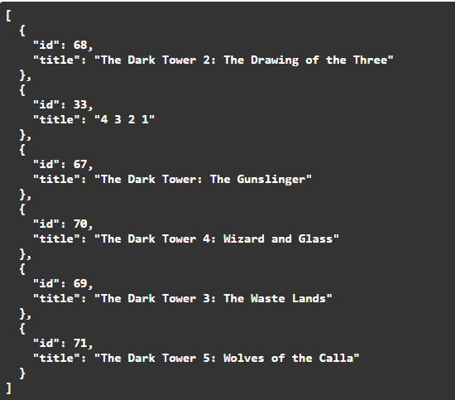
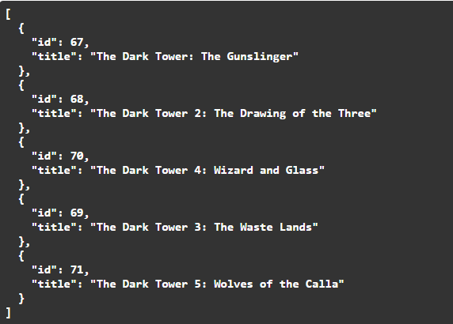
Query Matching
Simple Query
Simple Match returning all instances sorted with highest match score
Wildcard
A wildcard operator is a placeholder that matches one or more characters. For example, the * wildcard operator matches zero or more characters.
Query: tower 2
Query: tow*

Slide 14
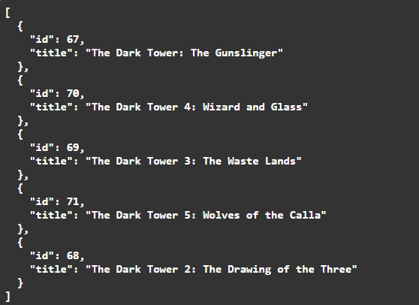
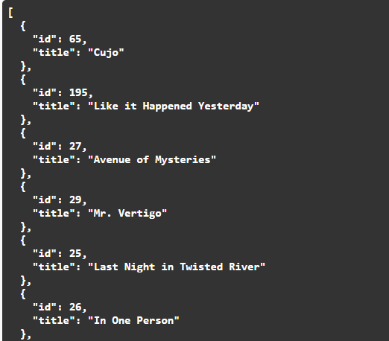
Phrase with Slop
Phrase matching requires the exact query given by the user to e matched in the exact order without no gaps.
Exception Matching
Used to return instances such that non of the tokens specified by user matches the instances.
Slop allows gaps within the phrase of up to specified number.
Query: the tower
Query: a The is 1 2 3 4 5

Slide 15
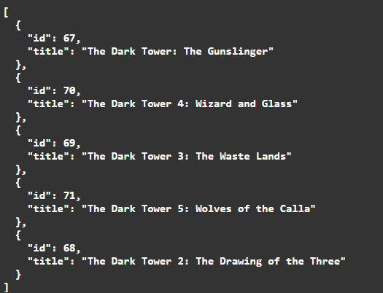
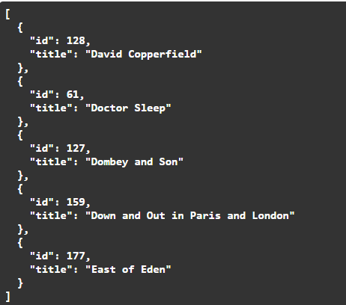
Page
Get all instances of the entity in a specific page by specifying the number of records per page.
Fuzzy Matching (also called Approximate String Matching) is a technique that helps identify two elements of text, strings, or entries that are approximately similar but are not exactly the same.
Fuzzy Search
Query: towir
Query: Limit=5, Page=7

Slide 16
Advantages over dbms
Full-text search systems excel at quickly and efficiently searching large volumes of text. This could include unstructured data like a Word document or semi-structured content like HTML web pages which have some structure and metadata, but mostly an abundance
Indexing
Increases Speed and Efficiency of search as word by word searching inside document is avoided.
Stemming
A full text search can stem words. If you search for run, you can get results for "ran" or "running".
Weighted Results
Custom Boosting can be done when searching multiple fields such that one field has higher “relevance” over another and if hence boosted.
“Book Title” can be boosted to have higher relevance score than “Book Description”.
Most full text engines have stem dictionaries in a variety of languages.
Instead when a word is searched, indexing provides the list of documents that contain the word.

Slide 17
Disadvantages
True Synonyms
Variant Spellings
Shortened Forms of Terms
Synonyms are two words that mean the same thing in one language. In full-text searching, synonyms hinder effective information retrieval where the system only returns results that match the term and does not return results that refer its synonyms.
Words that mean the exact same thing can sometimes be spelled differently, as in variant British and American spellings.
Abbreviations, acronyms, and initialisms can hinder full-text search because a document may contain only the short form of the word or only the long form.
In full-text searching, a search for "Colour" will miss results that use the spelling "color". Fuzzy Search can to an extent negate this problem.
Fight and Brawl have similar meanings but searching for one will not show results for the other.
Searching for “ASAP” will not return results for “as soon as possible”.
The Homonym Problem
The homonym problem occurs in full-text searching when a single word or phrase has more than one meaning. For example, “Cricket” can mean either the insect or the sport. Both results will show up, with no regard to the context.

